Slide 1

LABORATORY MANAGEMENT SYSTEM
- By Nikhil Lathiya & Ayush Chauhan
Notes:
© Copyright Showeet.com – Creative & Free PowerPoint Templates

Slide 2
INTRODUCTION
01

Slide 3
The Laboratory Management System is an efficient software solution that simplifies the management process and handles various elements related to laboratory operations.
By utilizing this software, laboratory workflows can be streamlined, and paperless records can be maintained, providing a more organized and efficient system.
Laboratory Management System
Notes:
© Copyright Showeet.com – Free PowerPoint Templates

Slide 4
Additionally, the Laboratory Management System enables users to book appointments online and download their reports, enhancing the convenience of the process for patients and healthcare providers alike.
The software also provides an integrated platform to manage laboratory workflows, including data management, thereby improving the efficiency and accuracy of laboratory operations.
Laboratory Management System
Notes:
© Copyright Showeet.com – Free PowerPoint Templates

Slide 5
FEATURES
01
Notes:
© Copyright Showeet.com – Creative & Free PowerPoint Templates

Slide 6
Features of Admin and Super Admin
Super Admin and Admin can add, view, delete, and edit patient details with OTP verification, ensuring the accuracy and security of the data.
Super Admin and Admin can generate, view, edit, and delete patient reports, making it easy to manage and retrieve patient data
Laboratory Management System
Notes:
© Copyright Showeet.com – Free PowerPoint Templates

Slide 7
Features of Admin and Super Admin
Super Admin can add or remove Admin, ensuring that only authorized individuals have access to the system.
Super Admin and Admin can view appointment requests submitted by patients and take action such as confirming or rejecting them.
Super Admin and Admin can view test details, with Super Admin being the only one who can add and activate or deactivate tests.
Laboratory Management System
Notes:
© Copyright Showeet.com – Free PowerPoint Templates

Slide 8
Features Of User
Users can book appointments online for a specified date.
Users can download their reports and bills online, making the process more convenient and saving time for both patients and staff.
Laboratory Management System
Notes:
© Copyright Showeet.com – Free PowerPoint Templates

Slide 9
BENEFITS
01
Notes:
© Copyright Showeet.com – Creative & Free PowerPoint Templates

Slide 10
Paperwork can be eliminated.
Managing data becomes easy.
Large number of data can be accessed with ease.
Patient Can book their appointment online.
E-bills and E-Reports Can be generated.
Patient can download their report by this website.
Analysis the ratio of patients, Reports & tests.
Laboratory Management System
Notes:
© Copyright Showeet.com – Free PowerPoint Templates

Slide 11
USECASE DIAGRAM
01
Notes:
© Copyright Showeet.com – Creative & Free PowerPoint Templates

Slide 12
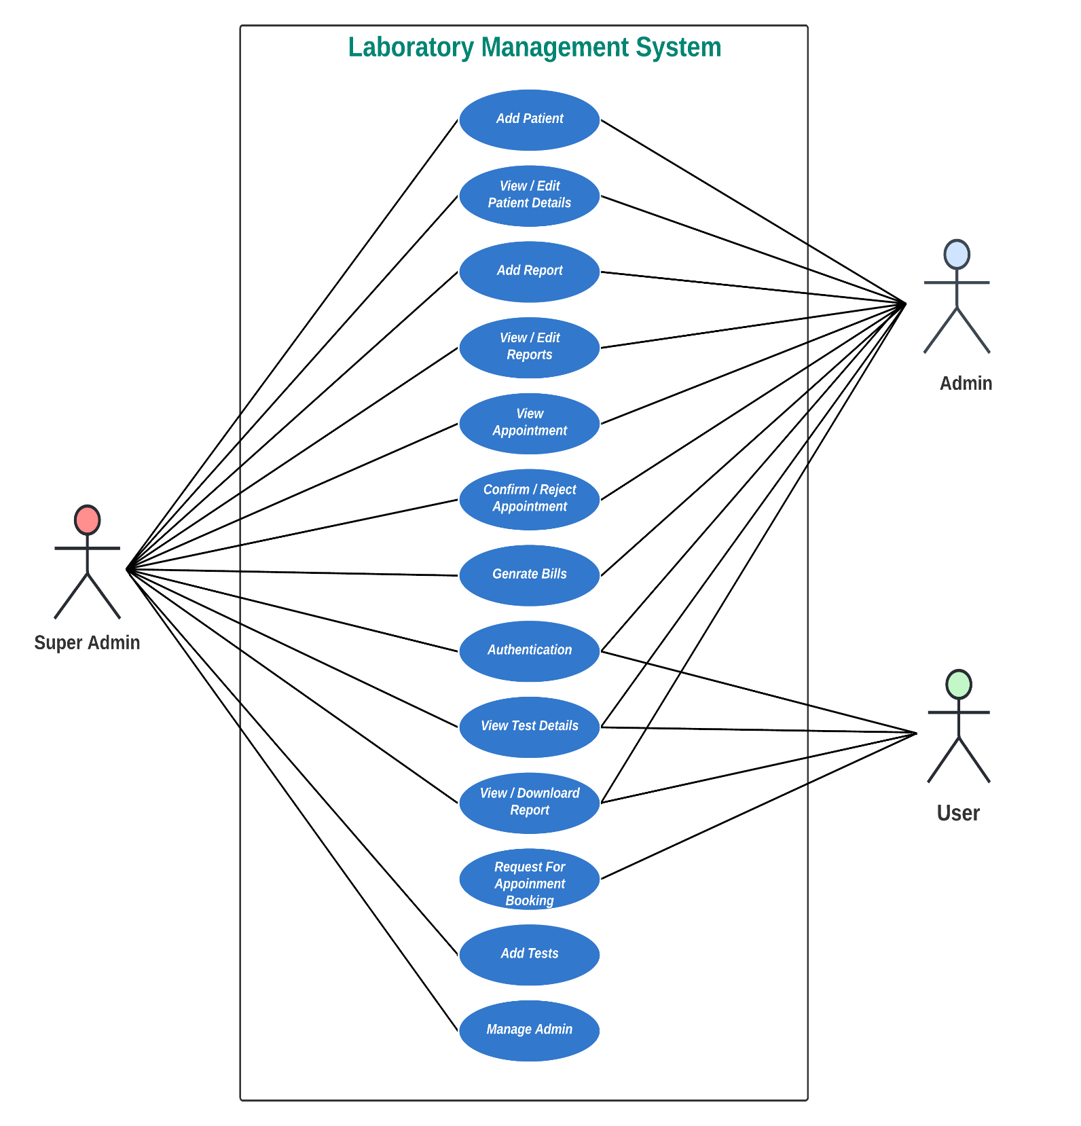
Laboratory Management System
Notes:
© Copyright Showeet.com – Free PowerPoint Templates

Slide 13
TIMELINE CHART
01
Notes:
© Copyright Showeet.com – Creative & Free PowerPoint Templates

Slide 14
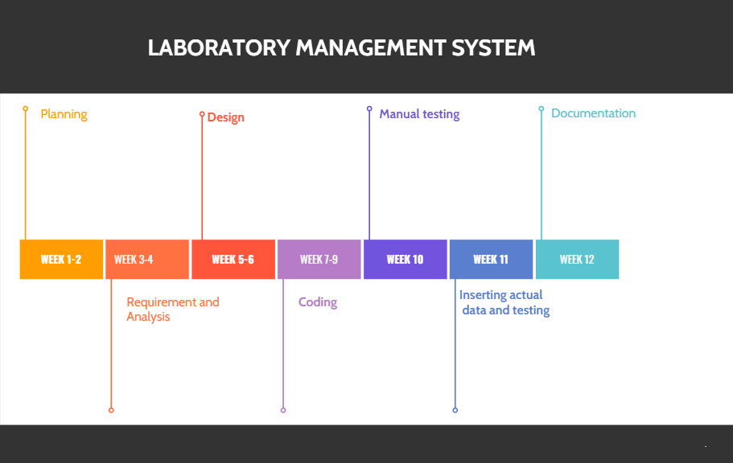
Laboratory Management System
Notes:
© Copyright Showeet.com – Free PowerPoint Templates

Slide 15
Thank You !
Notes:
© Copyright Showeet.com – Creative & Free PowerPoint Templates

